Slide 1
BrokerLess
Revolutionizing Renting on the Blockchain
Team 4: Joseph Pasik, Ava Lee, Shereef El-Prince, Kevin Qiu, Kebbin Eke

Slide 2
Key Challenges
Front end development
Limited investment options

Slide 3
Purpose
The purpose of our project is to decentralize the broker-tenant-landlord negotiations when renting an apartment

Slide 4
Proposition
For Landlords
Seamlessly find high-quality tenants
Reduce property vacancy times
Reduce the costs
Earn interest on security deposits
Reduce paperwork
For Tenants
Get paid (you are the broker!)
Earn more interest on your security deposits
Avoid penalties of lease terminations
Get your security deposits back faster
Reduce paperwork

Slide 5
Process Flow
Property gets listed
When the bid ends the winning bidder pays 3 people
Us (3%)
The Landlord (95%)
The former tenant (2%)
Bank Interest
Auction for property NFT
Goes into a joint account but there’s a record of each person's ownership of that account
Deposit amount equal to first month rent
Notes:
The bid is the 1st month’s rent (which is the same as the deposit).

Slide 6
Our platform deploys the auction, the lease and the omnibus account
Bid, withdraw funds if you lost the auction, and write the lease agreement for the winner of the auction
Notes:
Use states to prevent further auction bids at the close of the auction

Slide 7
Assumptions
Due to the time constraints the 1-month rent payment is the same as the deposit
Structured this process into 3 contracts
Large pool of money in the omnibus account
Auction
Lease Contract
Deposit

Slide 8
Auction
Highest Bidder Wins
Feeds into brokerless contract (money is split into 3 ways)
Deposit (safety deposit)
Rent
Fees paid to the former tenant, the landlord, and our platform

Slide 9
Brokerless Contract
The Landlord and tenant agree to a contract which specifies the duration of the lease, cost of rent, and any other conditions within a standard lease agreement

Slide 10
Brokerless Contract Code
Put the deposit contract in the same file (omnibus contract)
Using states for the contracts (when the landlord confirms and the tenant confirms then the state starts. Certain functions only work when certain states are triggered
Constructor that sets the rent deposit, spt, us, service fee payment, and showing fee percent
Created at the creation of th
Terminated when the contract is terminated
Landlord confirm -
Tenant confirm-
Initial payout - when the auction finishes the rent and the deposit are a part of the bid. They get sent over to the brokerless contract. The previous is getting their showing fee, the landlord is getting the rent, and we are getting our percent
Pay Rent
Request Deposit
Get balance
Contract Termination
Request showing fee
Modifiers only certain states or individuals can perform certain functions

Slide 11
Deposit
Upon payment the security deposit is then collected by our platform and pooled together to be invested in a high yielding FDIC savings account. Our platform allows for both the tenant and landlord to have

Slide 12
Omnibus Contract (address)
Return Deposit function (to the tenant) landlord is in control
Get deposit from the tenant
Return deposit to the tenant (tenant, amount)
Release interest to the tenant
Release Interest Landlord
Release Interest (send Tenant their share of the interest, and our share of the interest)

Slide 13
Fees
Transaction Success (new tenant acquired)
Subscription for premium service(s)
Tenant Finder
Property Maintenance
Transaction Processing
Asset Management Servicing

Slide 14
Success Fee
May be triggered upon successful acquisition of a new tenant
The contract may be initiated by either the landlord or former tenant in the event that neither party is willing to engage in the search process themselves

Slide 15
Additional Features
Tenant Background Checks
Credit Check, Tenant Rating, income verification, Blockchain Identification Verification
Landlord Background Checks
Landlord Rating, Property history
Expanded deposit investment options
Crypto staking, mutual fund investments, ETFs, etc.
Expanded Payment Features
Late payment fees, upfront rent pay, deposit payment flexibility
Add actual lease contracts

Slide 16
Additional Explanation on Workflow
Deposit.sol
From tenant
2% for tenant
0.5% landlord
1% us
Percentage could vary
BrokerlessAuction.sol
HighestBidder -> tenant
Landlord
BrokerlessContract.sol
Omnibus Account

Slide 17
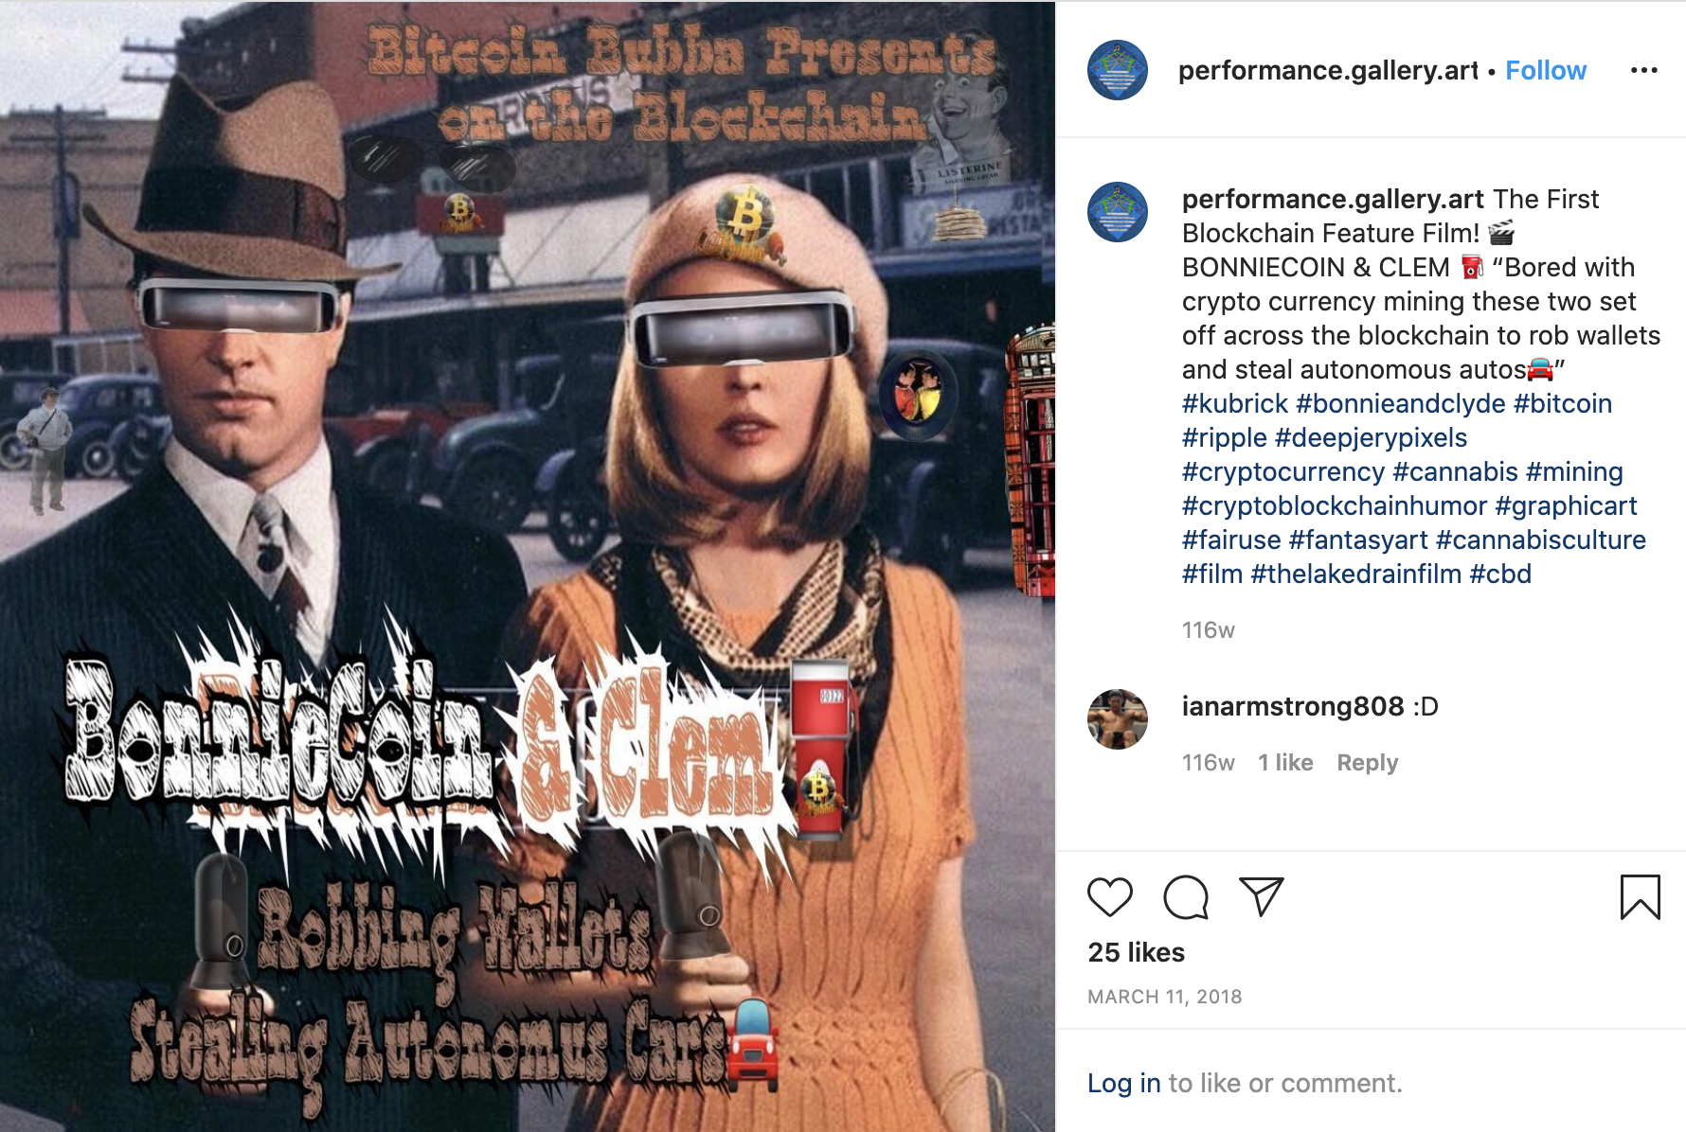

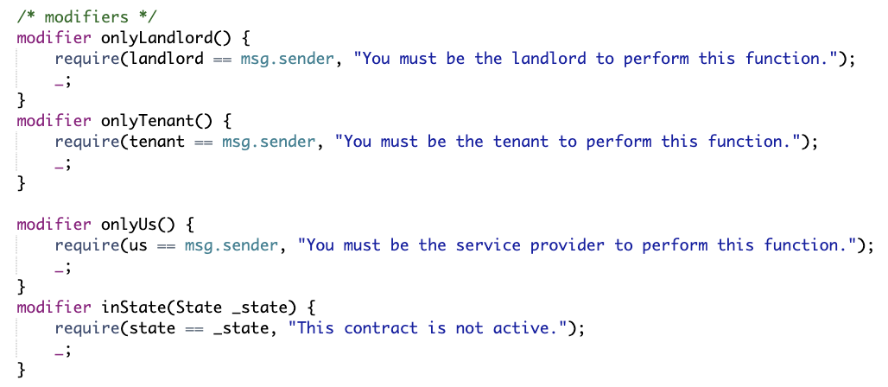
Bug Fixture
https://www.instagram.com/p/BgLt5x5HRrv/

Slide 18
This is only the BEGINNING!!! Step 1:
i) As Landlord deploys Auction contract
ii) As Us deploy Lease contract
iii) As Us deploy the Omnibus contract
iv) As the bank generate funds through BankInterest contract
** Insert bank interest 5%
* Set leaseAddress contract
* Set omnibusAddress contract
* As potentialTenant 1 enter bid Value and split Value between
rent percent and deposit percent
* As potentialTenant 2 enter higher bid Value and split Value
between rent percent and deposit percent
* As potentialTenant 1 withdraw bid to get back money
* As Landlord end auction and accept highest bid. Resulting in the rent being transferred
to lease contract and deposit gets transferred to the Omnibus contract
** Navigate to the Lease contract. As Landlord confirm lease contract
** As Tenant confirm lease contract
* Set Omnibus contract
* Set Previous contract
* Click initialPayout
* Rent payment is transferred to Landlord and Previous Tenant for showing
the house and Us for offering the platform
** In the Previous Tenant Agreement set
* Click PayRent
* After duration press requestDeposit

